Slide 1
NYC Housing Price Disparities
By Amrit Chandrasekaran, Zain Sadiq, Frank Schneider
Information Visualization 04:547:321:11

Slide 2

Project Overview
This project is intended to analyze housing disparities across New York City
We aim to highlight differences in affordability and housing activity across boroughs and ZIP codes
Using data visualizations, we compare average sale price, transaction volume, and geographic patterns

Slide 3

Data Source
Dataset: NYC Property Sales Data
Source: Public dataset from Kaggle containing housing transaction data across NYC boroughs
Contains housing transactions from Sep 2016 - Sep 2017
Notes:
Dataset Source: https://www.kaggle.com/datasets/new-york-city/nyc-property-sales

Slide 4
Data Preparation
Combined separate boroughed datasets into one dataset
Added a borough column to label each record
Structured the data for analysis in Tableau

Slide 5
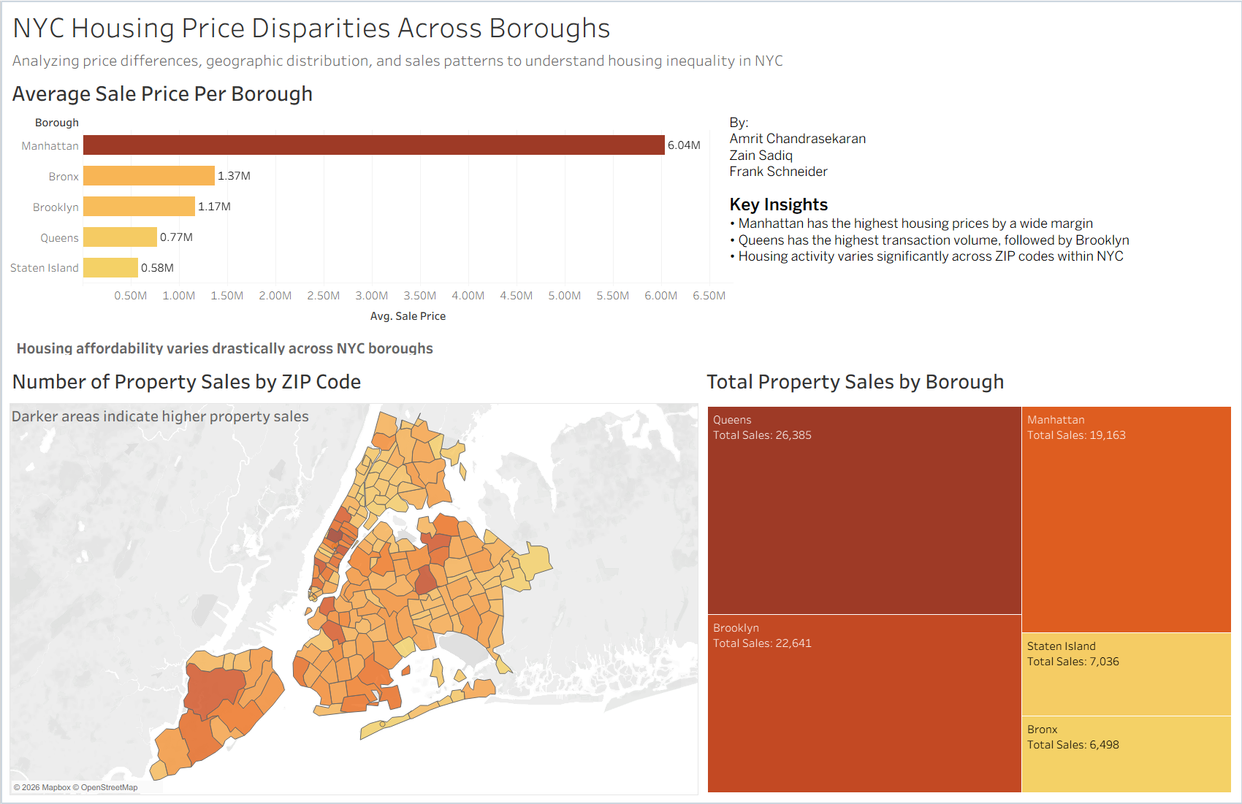
Final Dashboard
Notes:
This slide shows our final dashboard, which brings together multiple visualizations to represent housing data across New York City.
At the top, we have a bar chart showing the average sale price by borough.
On the bottom left, we included a map that displays property sales by ZIP code, where darker areas indicate higher activity.
On the bttom right, we have a treemap that compares total property sales across boroughs.
Together, these visualizations help viewers understand both pricing differences and housing activity across NYC.

Slide 6
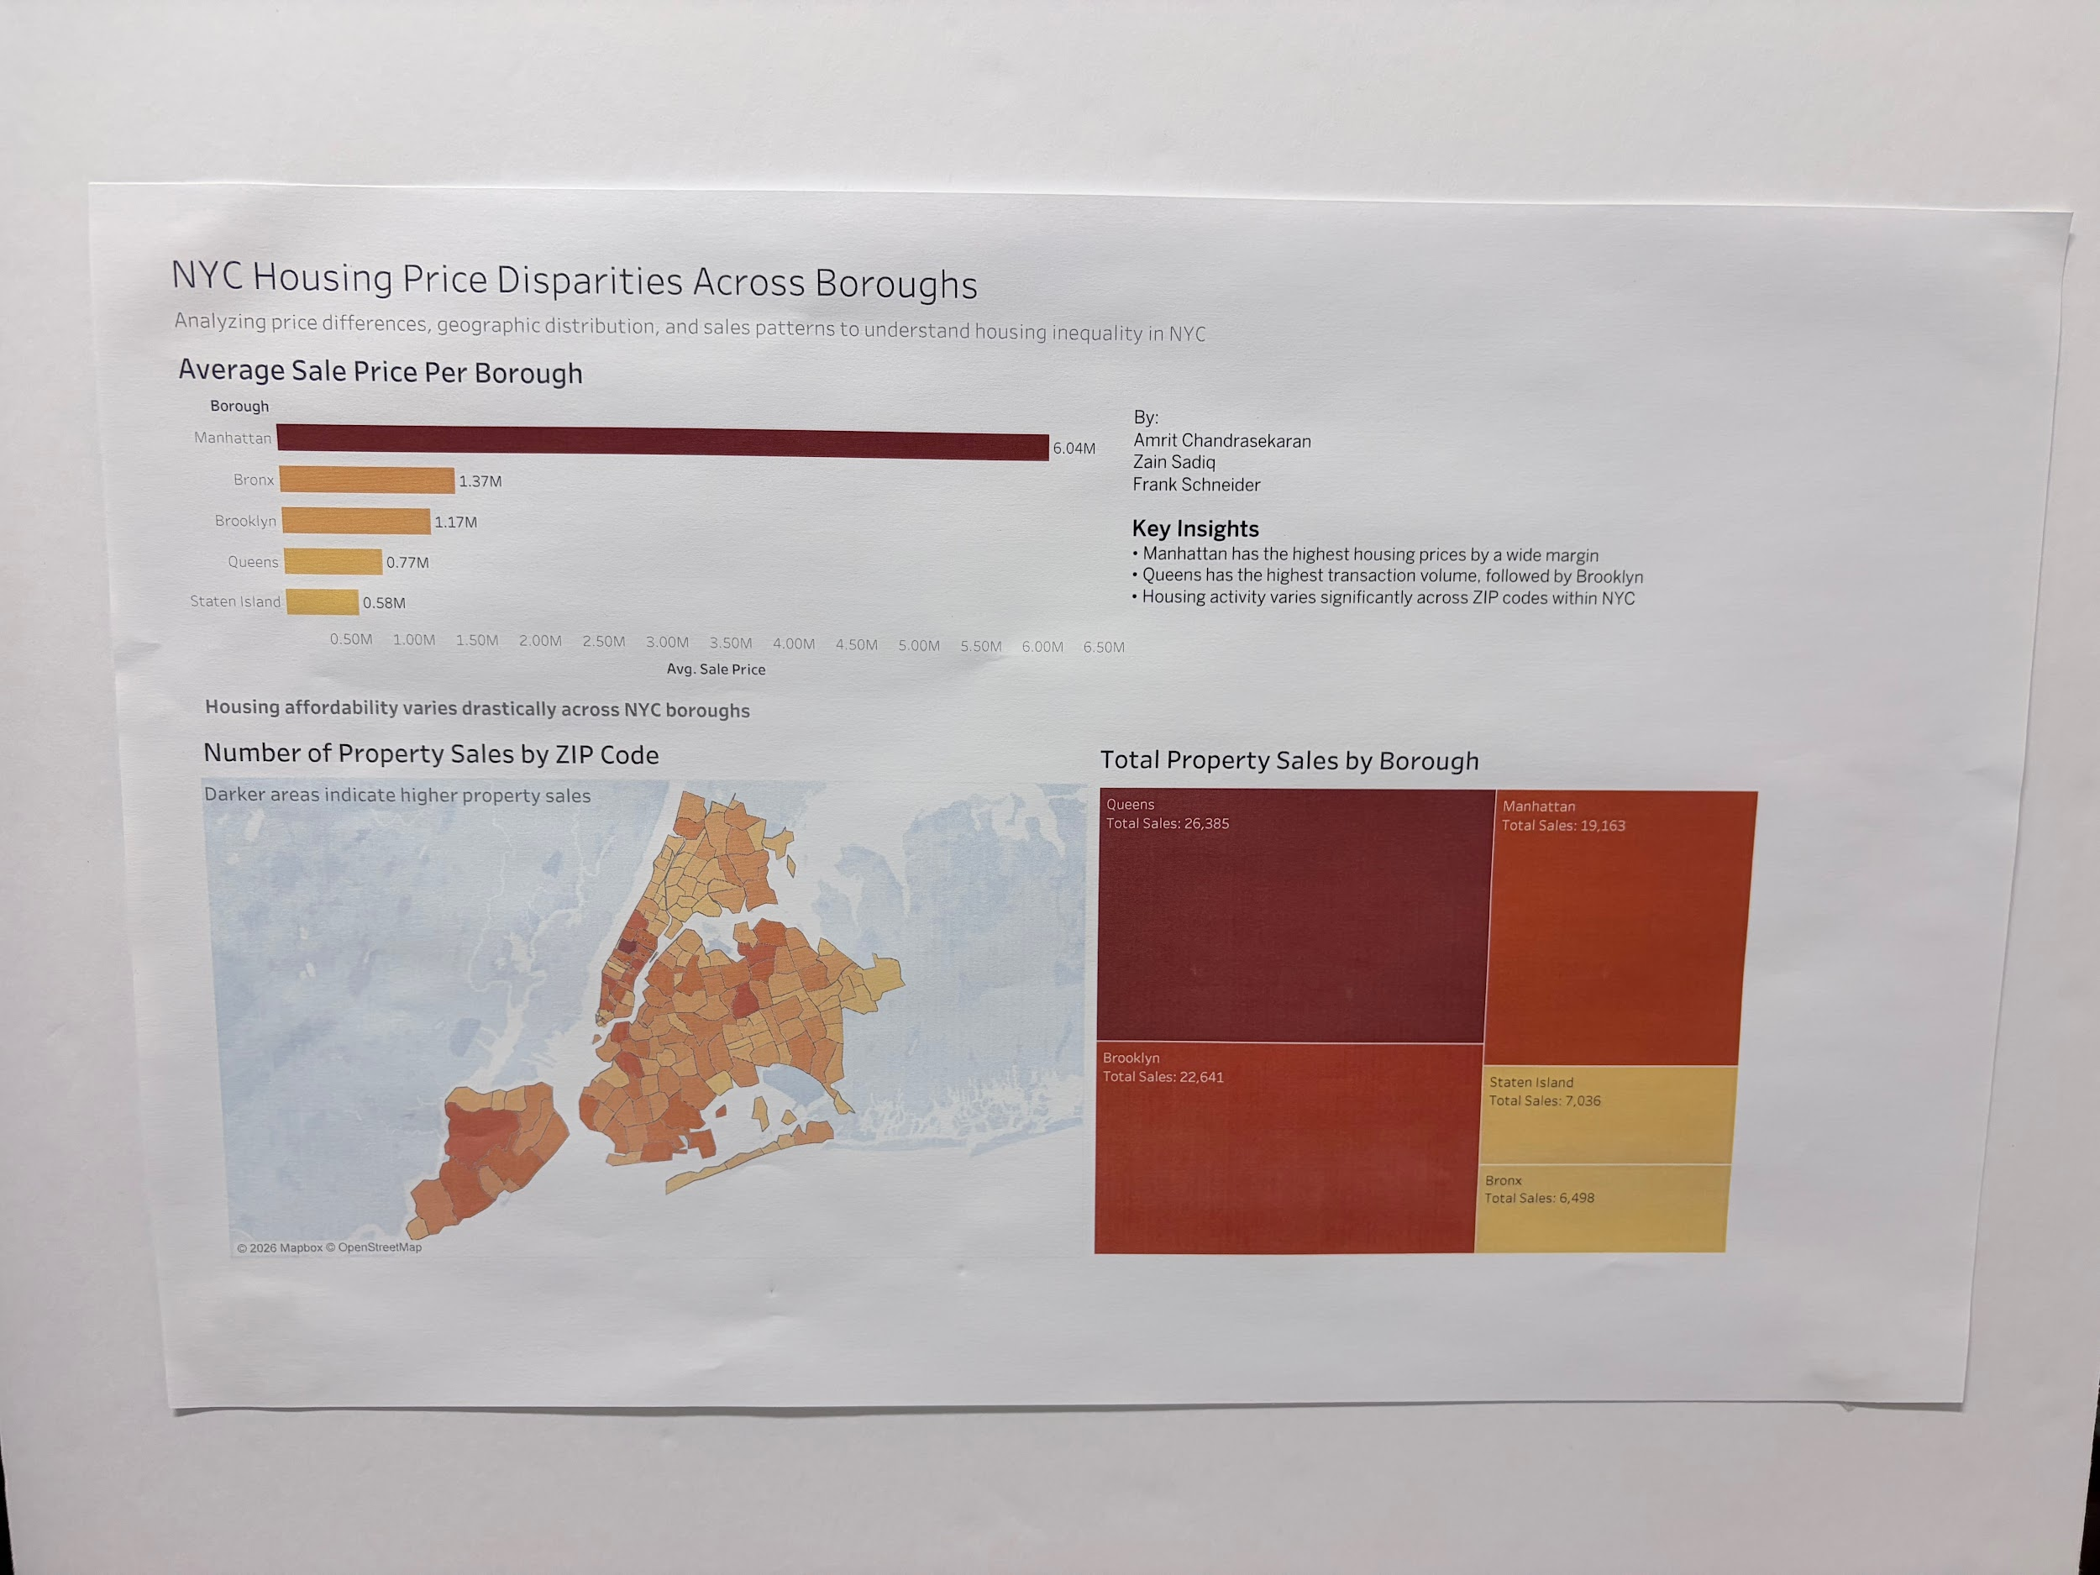
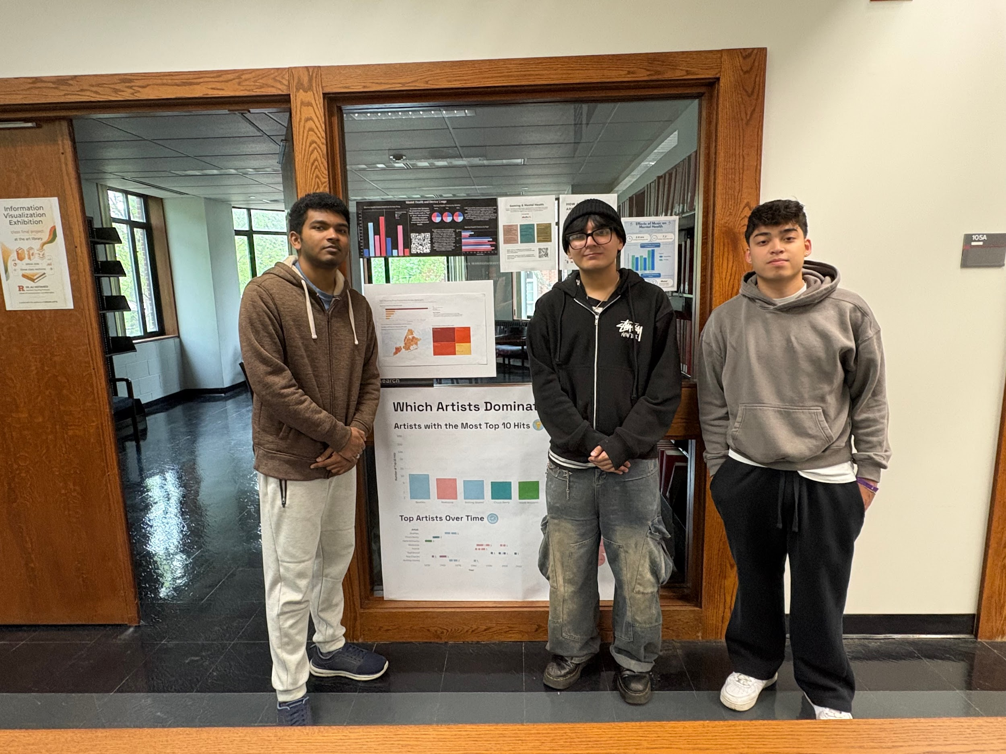
Physical Object
Notes:
This slide shows our physical installation of the dashboard.
We printed the dashboard in an 11 by 17 format and mounted it on a foam board to make it more durable and visually clear for public display.
We chose to place it in the Rutgers Art Library because it is a high-traffic study space where students frequently pass by and engage with visual materials.
This location is especially relevant for students who may be considering moving to New York City for jobs, as it gives them a quick understanding of housing trends, including which areas are more expensive and where most activity occurs.
Overall, the goal of the physical installation is to make the data accessible and easy to understand in a real-world setting.

Slide 7
Key Insights & Design Choices
Key Insights:
Manhattan is a clear price outlier (~10x higher than Staten Island)
Queens has the highest transactional volume, followed by Brooklyn
Sales occur citywide, but high-value areas are concentrated in Manhattan
Design Choices:
Darker colors emphasize higher-price areas, making Manhattan stand out immediately
Horizontal bar chart makes the ranking across boroughs easy to compare at a glance
Map and treemap complement each other. One shows where activity happens, the other shows how much
Notes:
This slide highlights the key insights and design decisions from our dashboard.
Starting with the insights, Manhattan is a clear price outlier, with average sale prices significantly higher than the other boroughs.
In terms of activity, Queens has the highest transaction volume, followed by Brooklyn.
We also see that sales occur across the entire city, but higher-value properties are concentrated in Manhattan.
In terms of design choices, we used darker colors to emphasize higher-price areas, which helps Manhattan stand out immediately.
The horizontal bar chart makes it easy to compare boroughs at a glance.
Finally, the map and treemap complement each other—one shows where activity happens geographically, while the other shows how much activity occurs across boroughs.

Slide 8
Connection
Installed at the Rutgers Arts Library for easy student access
Helps students considering moving to NYC understand housing trends
The poster gives a quick overview, while the dashboard allows deeper exploration.

Slide 9
Team Roles
Zain: Proposed the project idea and contributed to dataset selection and overall direction
Amrit: Led the development of the Tableau dashboard, including data analysis and visualization design
Frank: Designed and assembled the physical installation and contributed to presentation planning

Slide 10
Challenges
Printing challenges - difficulty finding printers that support 11x17 and ensuring correct formatting
Designing non-redundant visuals - adjusting the map to show different information than the bar chart
Balancing clarity and detail - simplifying the dashboard while still conveying meaningful insights

Slide 11
Thank you for your time!

